Slide 1
Lecture 21

Slide 2
Lecture 21 objectives
Understand and describe conversion of Pyr → AcCoA
Understand and describe regulation of PDH
Apply knowledge of regulation to explain physiology of Glc metabolism
Understand and describe TCA reactions

Slide 3
Cellular compartments
Where does Glycolysis occur?
Where does TCA occur?

Slide 4
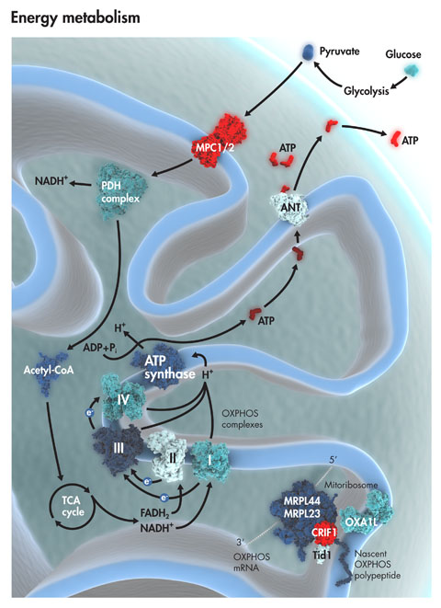
Cellular compartments
http://www.sabiosciences.com/pathwaymagazine/minireview/mitchondrial_energy_metabolism.php

Slide 5
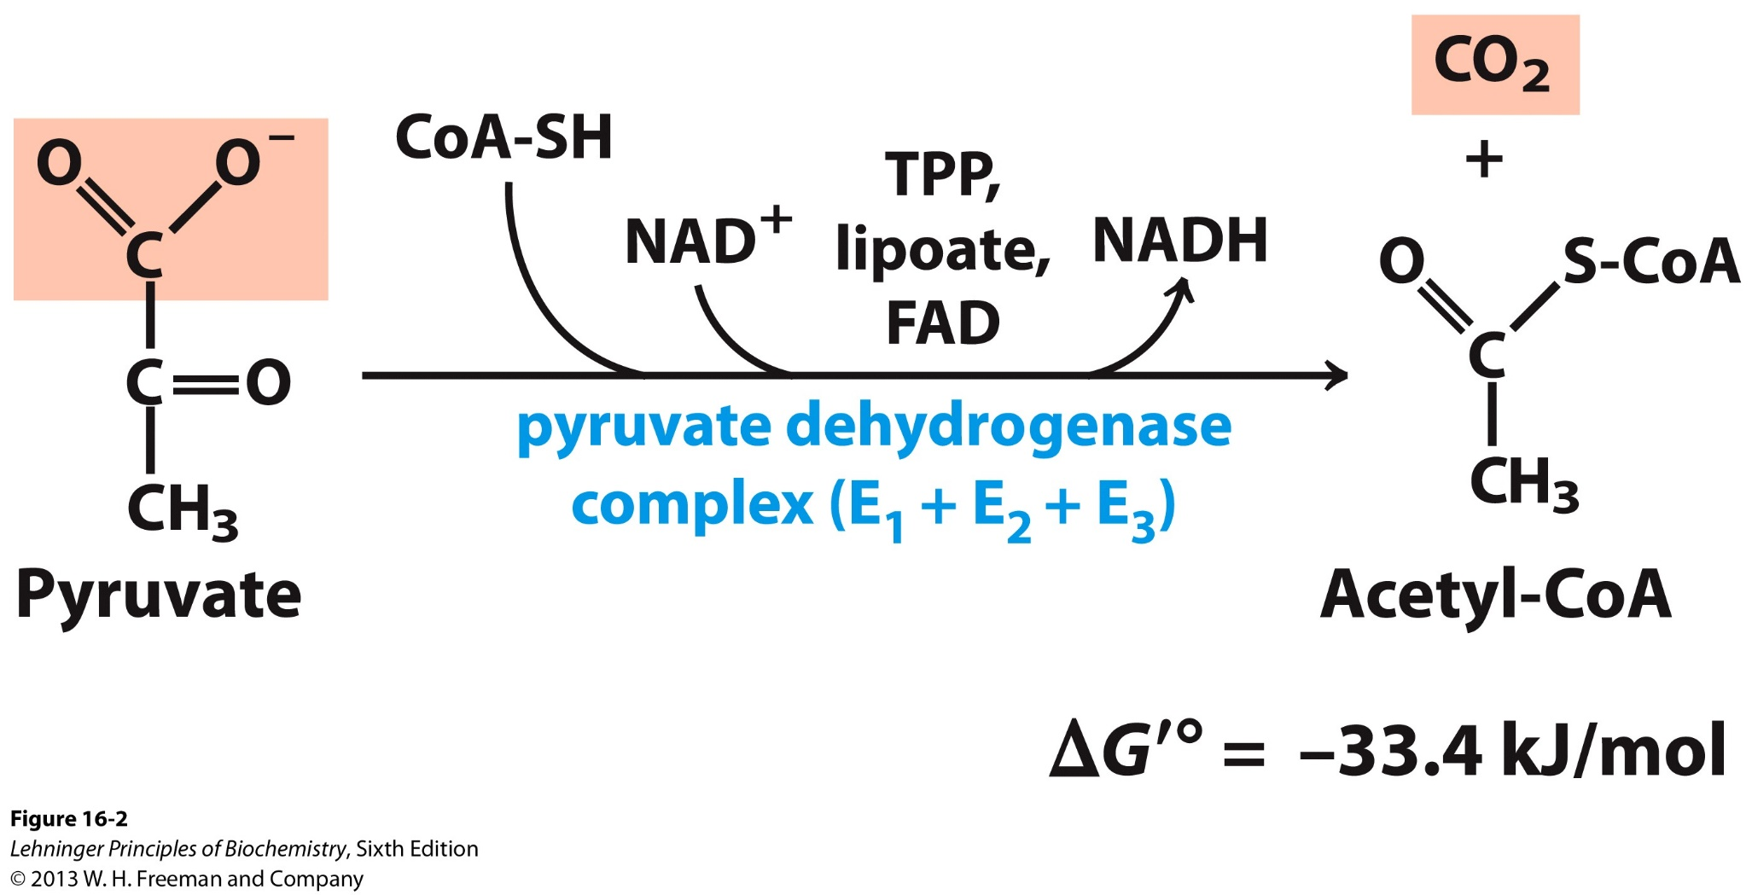
Pyruvate → Acetyl CoA

Slide 6
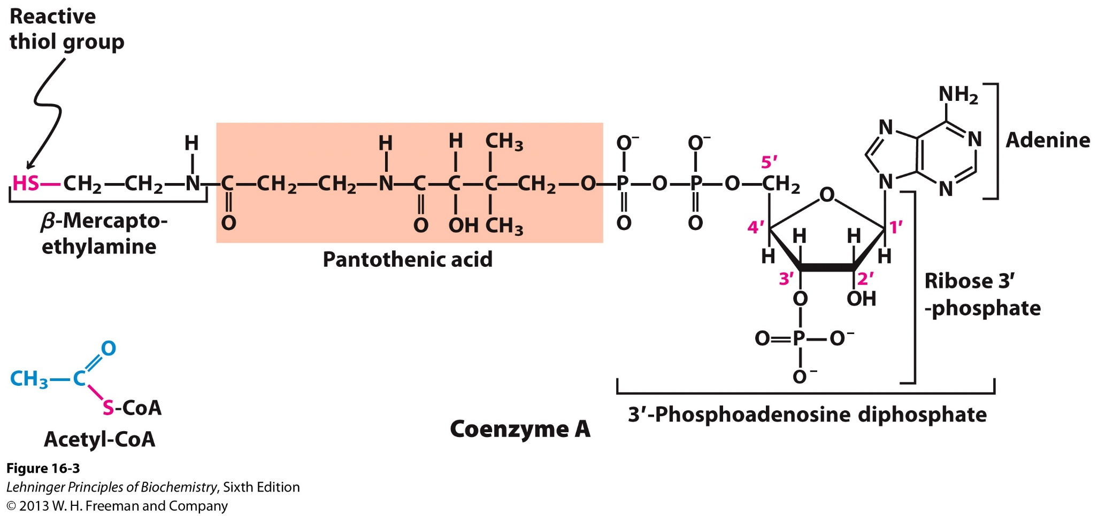
What’s CoA?

Slide 7
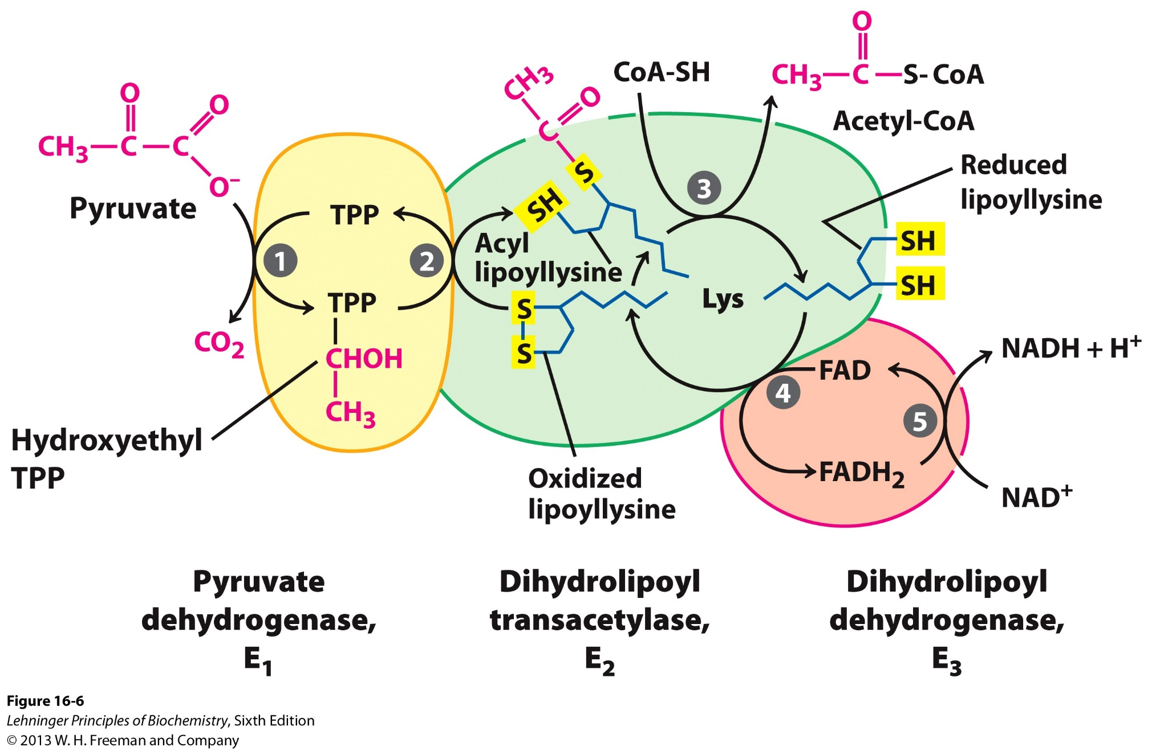
Pyruvate → Acetyl CoA

Slide 8
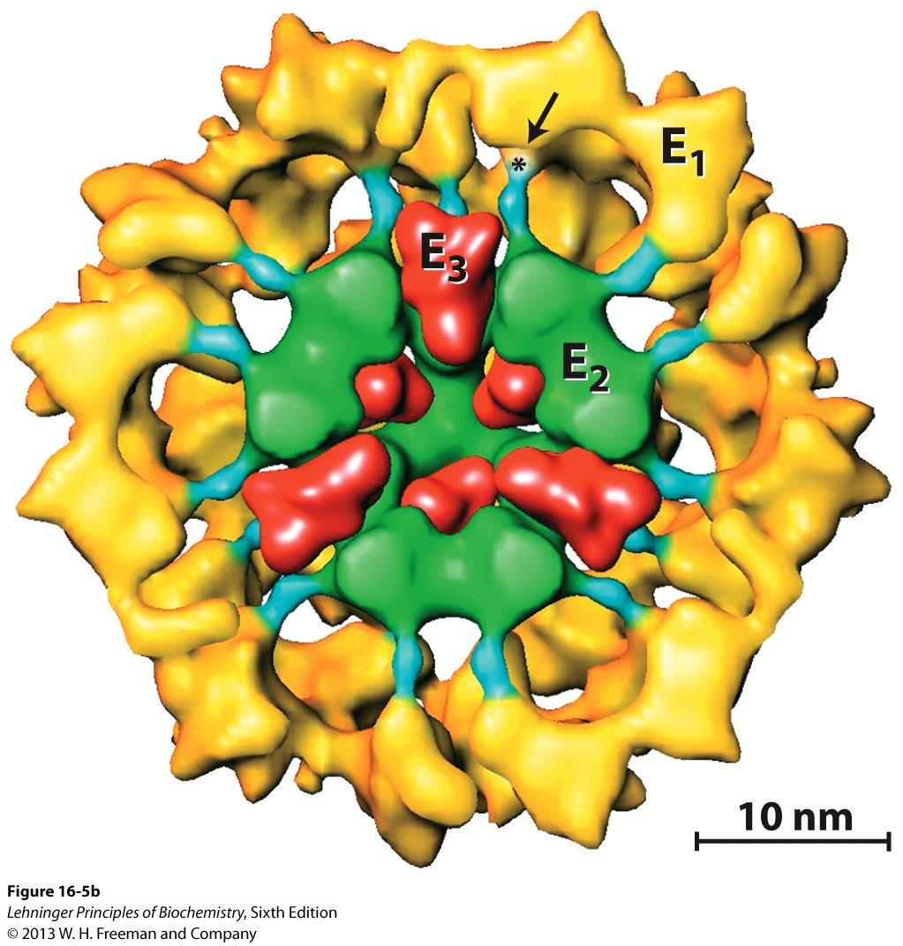
Pyruvate → Acetyl CoA

Slide 9
Pyruvate → Acetyl CoA

Slide 10
PDH gels
Purified PDH. Run on Native gel, and SDS gel. How many bands in each?
A. Native = 3; SDS = 3
B. Native = 1; SDS = 3
C. Native = 3; SDS = 1
D. Native = 1; SDS = 1

Slide 11
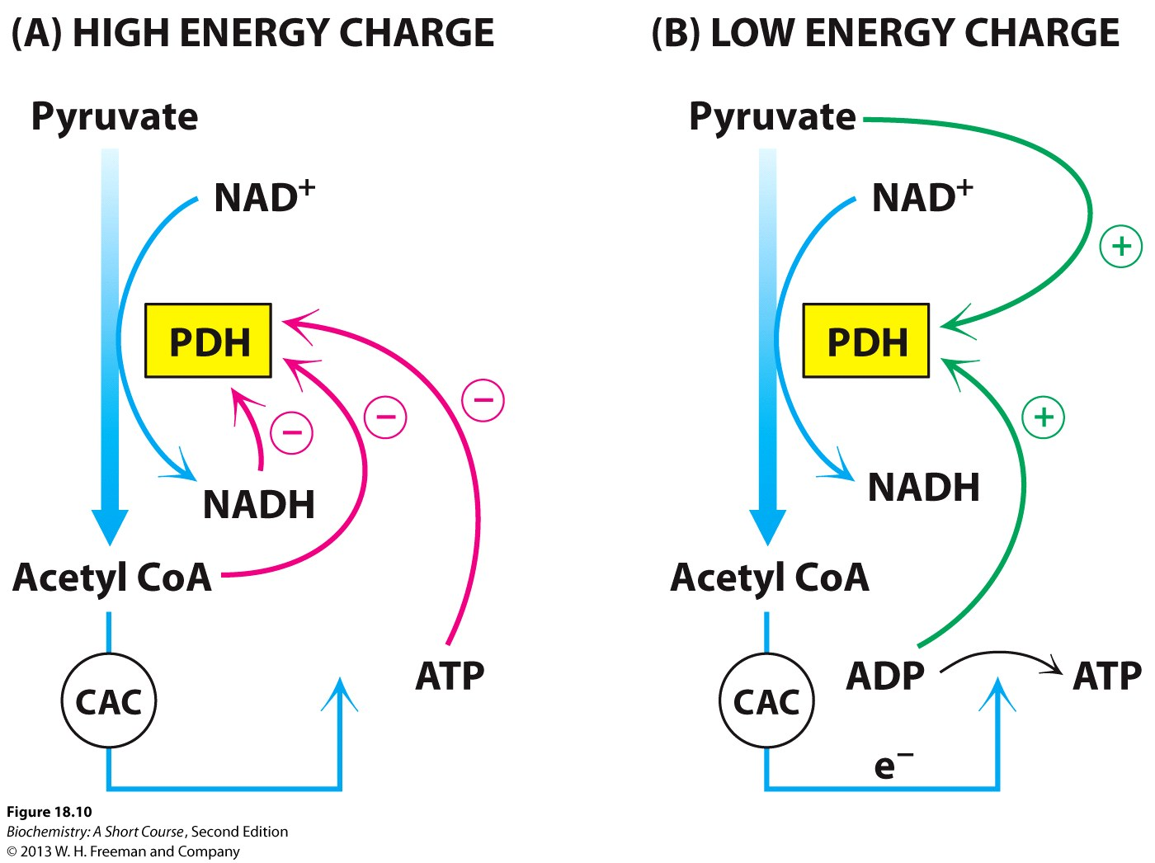
Regulation layer one: Within cell

Slide 12
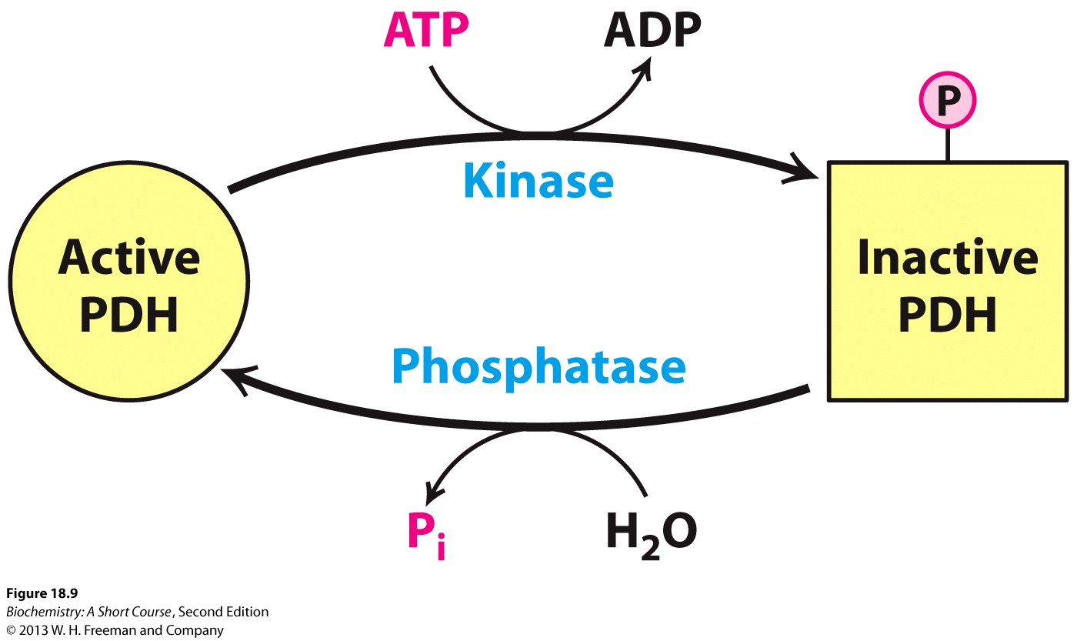
Regulation layer two: Signaling

Slide 13
Sound familiar?
Nicotinic acid → NAD
What are these molecules more commonly called?
Riboflavin → FAD
A. Cigarette smoke
Pantothenic acid → CoA
B. Fish oils
C. Vitamins
Biotin
D. Snake oil

Slide 14
Sound familiar?
Nicotinic acid → NAD
Riboflavin → FAD
Pantothenic acid → CoA
Biotin

Slide 15
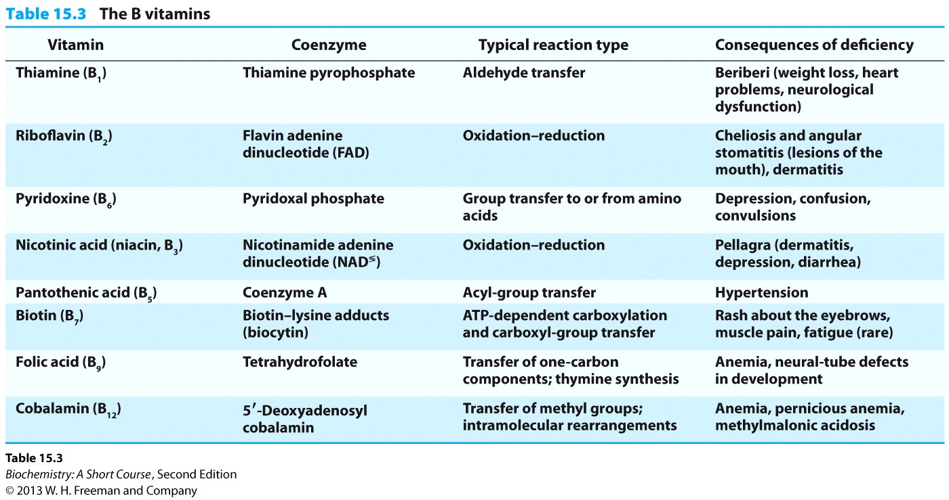
Vitamins are metabolic cofactors
Give rise to different “carriers”
Need small amounts – cyclic!

Slide 16
Vitamin deficiencies
Vitamins are metabolic cofactors
Required in most cells
Vitamin deficiency should affect most cells
Why do we see effects only in some tissues?

Slide 17
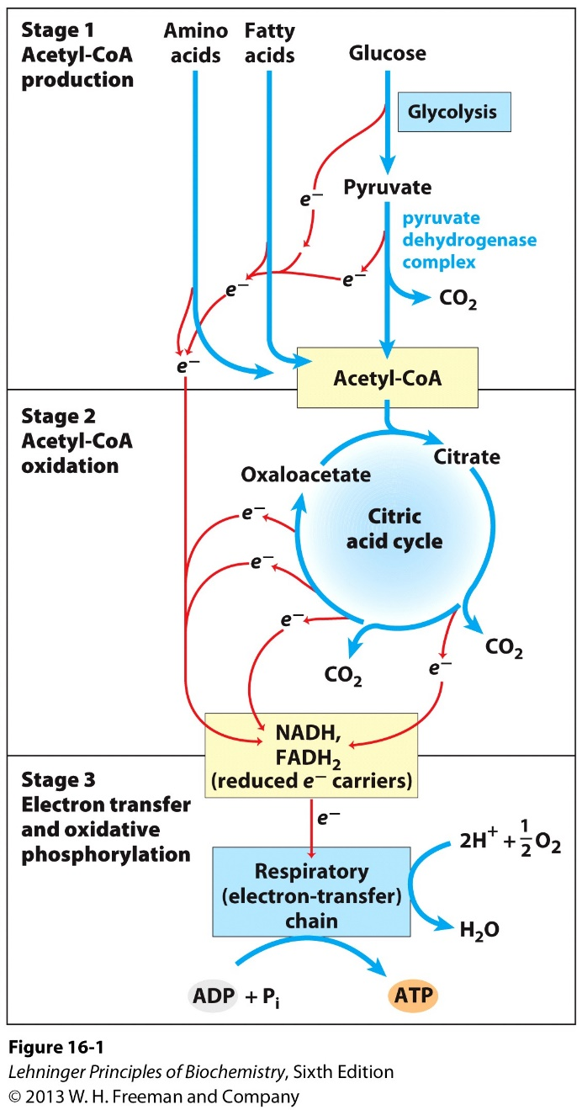
Energy generation overview

Slide 18
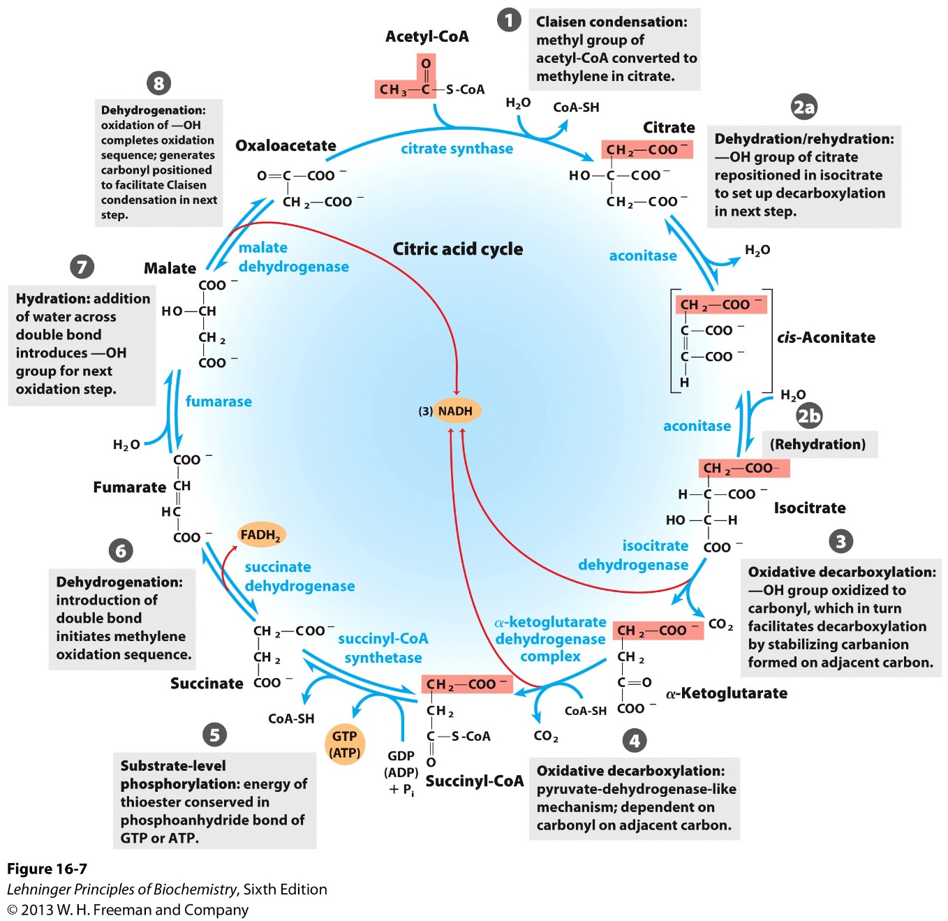
The TCA

Slide 19
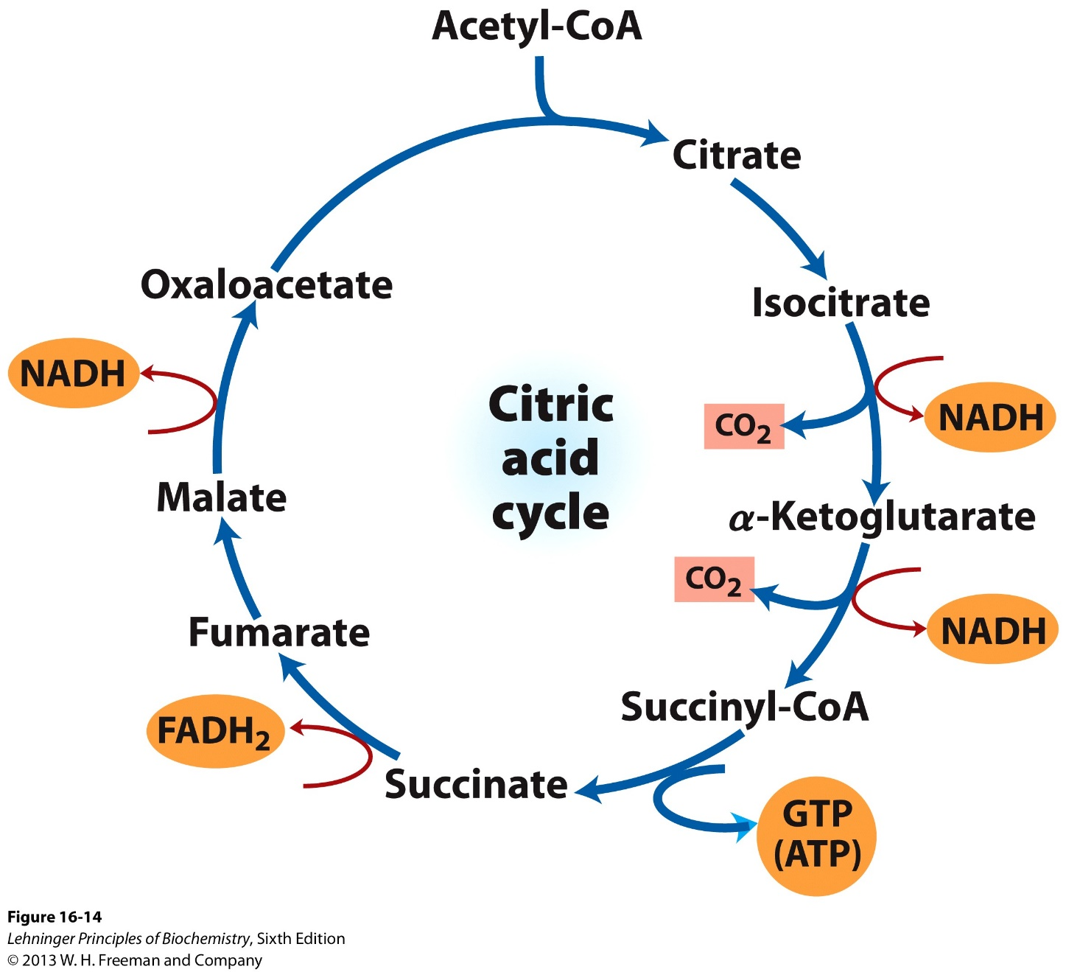
TCA energy production

Slide 20
TCA energy production

Slide 21
TCA energy production

Slide 22
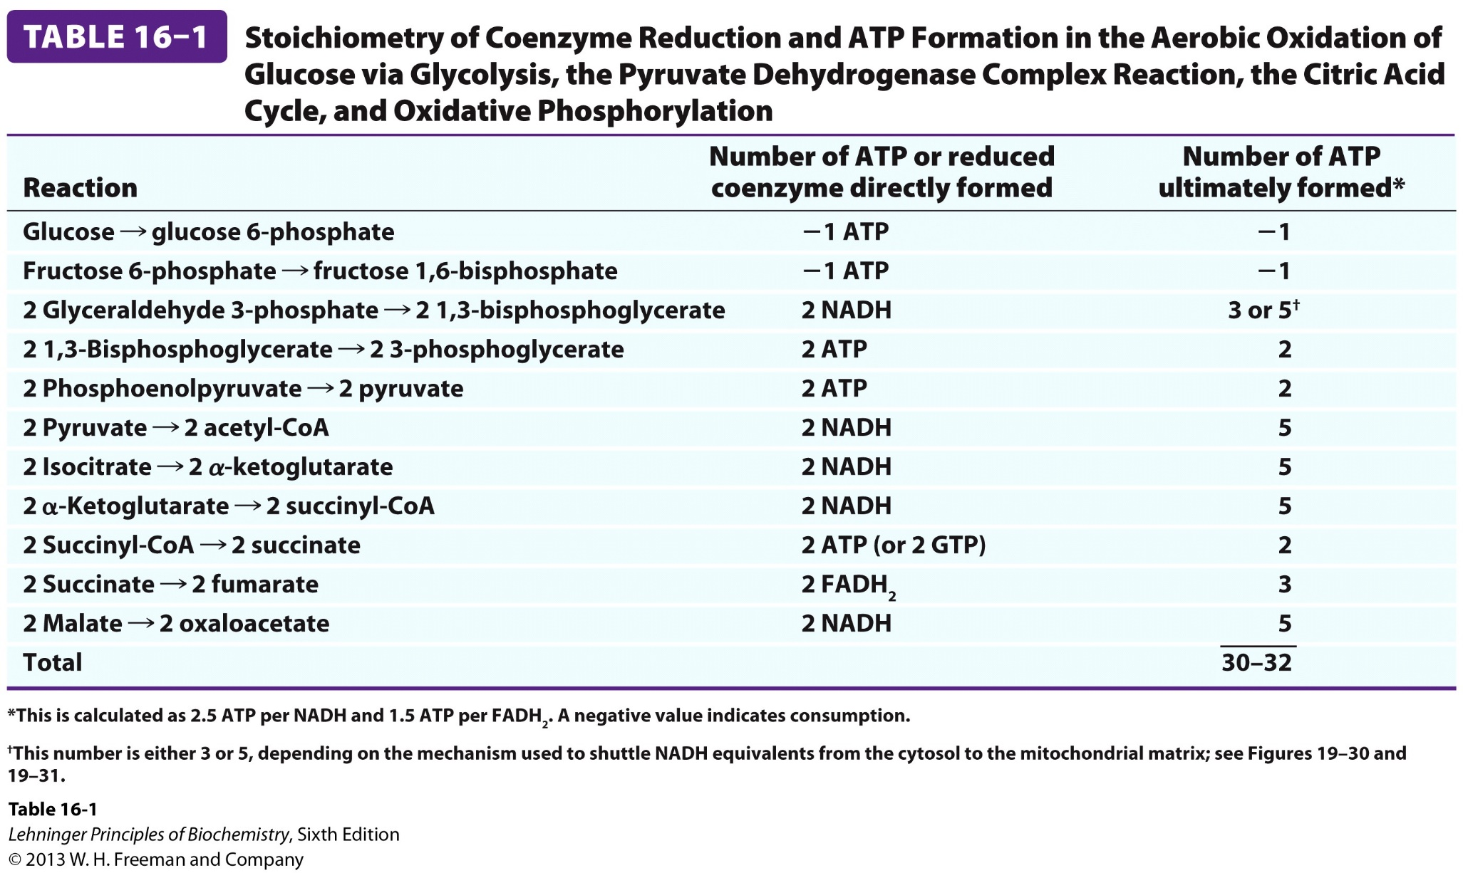
Glucose energy production

Slide 23
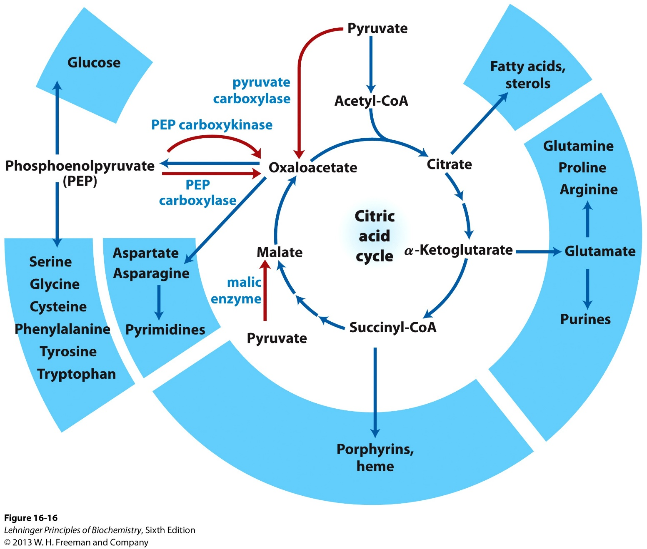
Anabolic roles of TCA

Slide 24
Funky cycles…
Acetyl CoA
Amino acids, etc.
Oxaloacetate
Citrate
Fatty acids, etc.
Oxaloacetate
Citrate
Malate
Malate

Slide 25
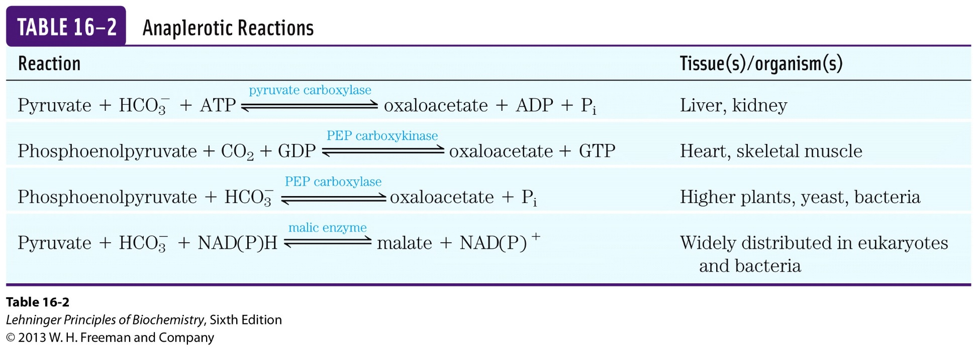
Anaplerotic reactions

